Slide 1
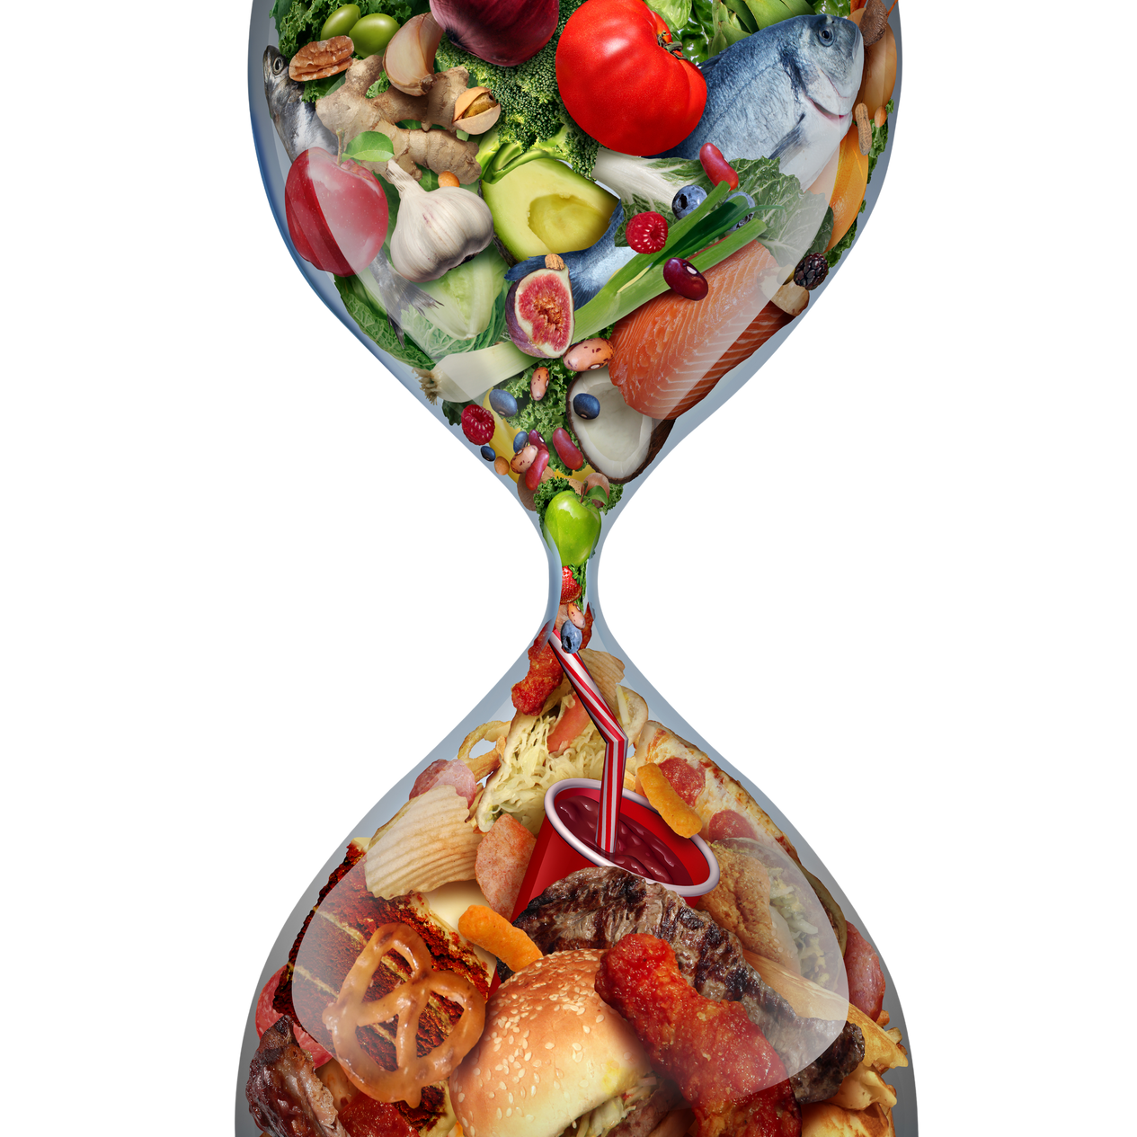



Momentum Short-term Insurance
EASY
HEALTHY
RECIPES
Presented by: Yannis Beukes

Slide 2
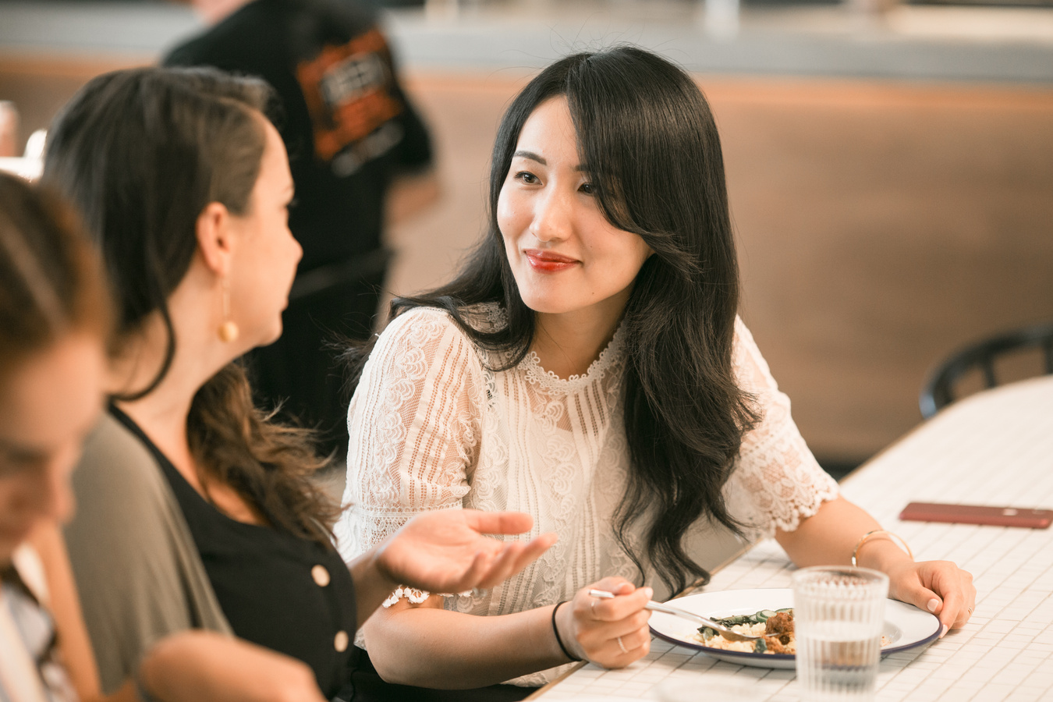
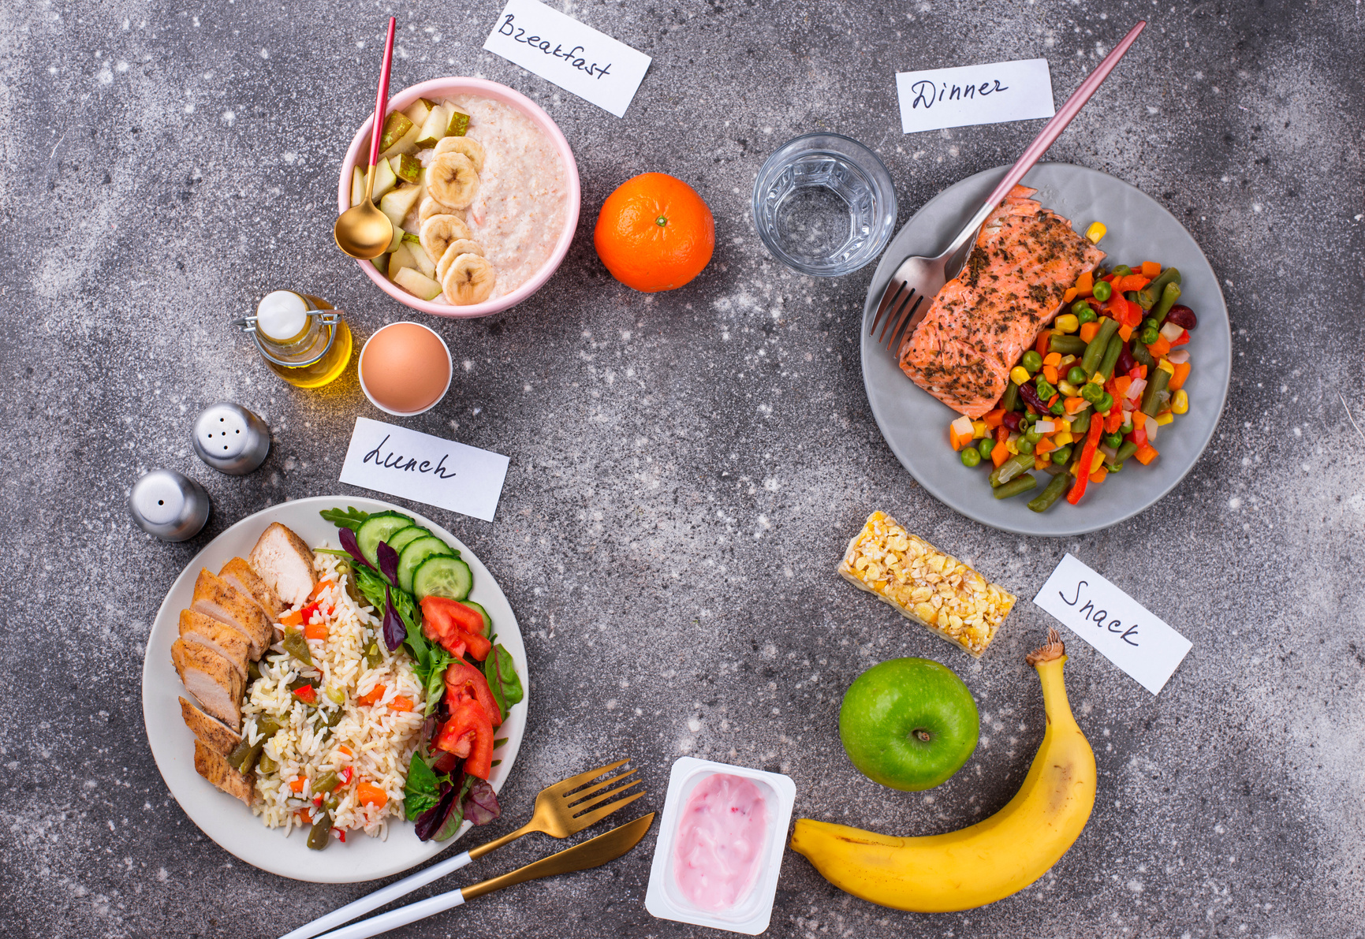

TABLE OF
CONTENTS
1
NUTRITION IN WORKPLACE
2
BREAKFAST OPTIONS
3
LUNCH OPTIONS
4
DINNER OPTIONS
5
SNACKING
6
MEAL PLANNING AND PREP

Slide 3



NUTRITION IN WORKPLACE
Increased focus levels
Quality nutrition supports mental clarity and concentration during work hours.
Enhanced productivity
Healthy eating can lead to increased productivity and better decision-making.
Increased energy
Proper nutrition provides sustained energy levels throughout the workday.

Slide 4
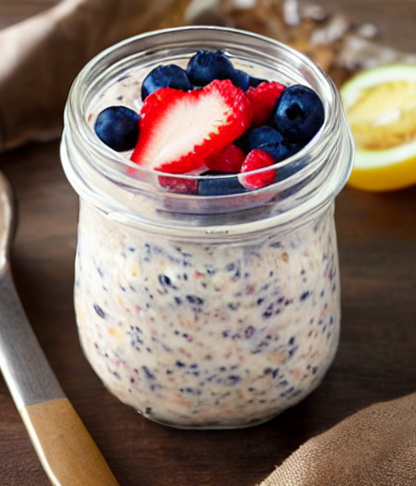
BREAKFAST
Overnight Oats
  rolled oats
  milk
  yogurt
  chia seeds
  Add-ins + toppings – Here’s where you can get creative. Just like with regular stove top oats, there are some classic add-ins like vanilla extract, ground cinnamon, maple syrup (or honey) and a pinch of salt that really elevate the flavor and make overnight oats super tasty.
1
I recommend a 1:1 ratio of rolled oats to milk, plus half as much yogurt.
Add oats, milk, yogurt, maple syrup, chia seeds, vanilla and sea salt into a jar, storage container with a lid or a bowl. Stir ingredients together. Place in the fridge overnight.

Slide 5
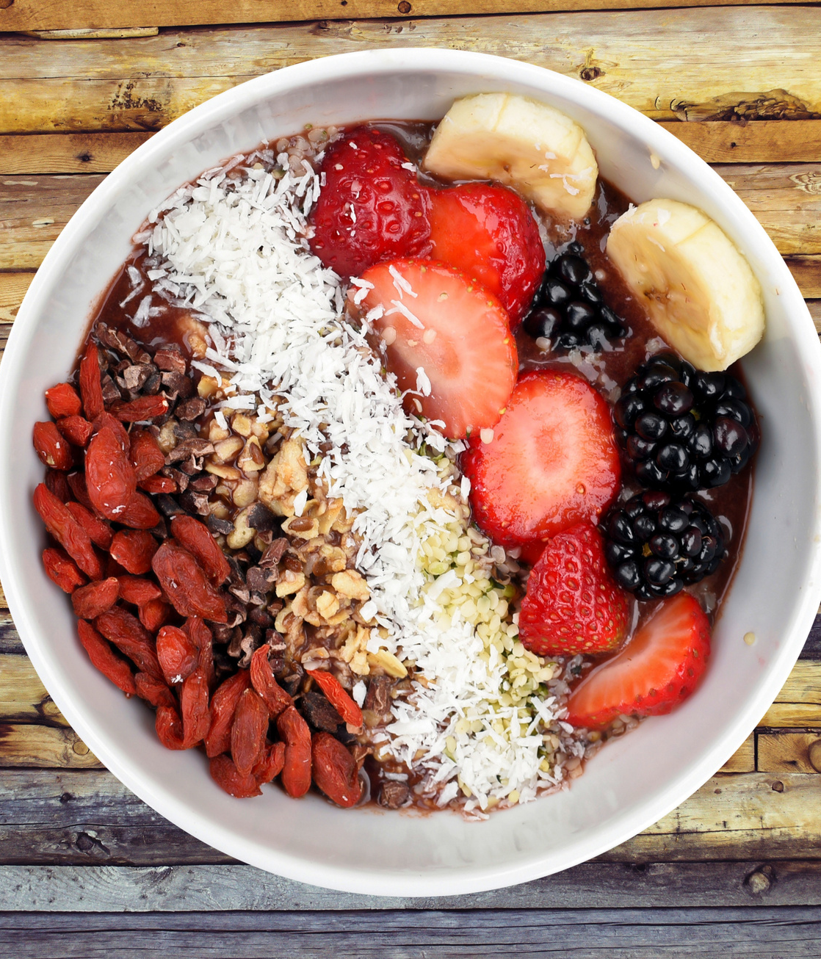
BREAKFAST
Fruit Bowl
  Greek yogurt
  bananas (super-ripe)
  pinch cinnamon
  Granola
  frozen mixed berries
  milk
  fresh seasonal fruit,
2
Blend the yogurt, bananas, cinnamon and mixed berries in a blender until smooth. Pour in a bowl
Add Granola and seasonal fruit like strawberries, or even sliced oranges for Vitamin C

Slide 6
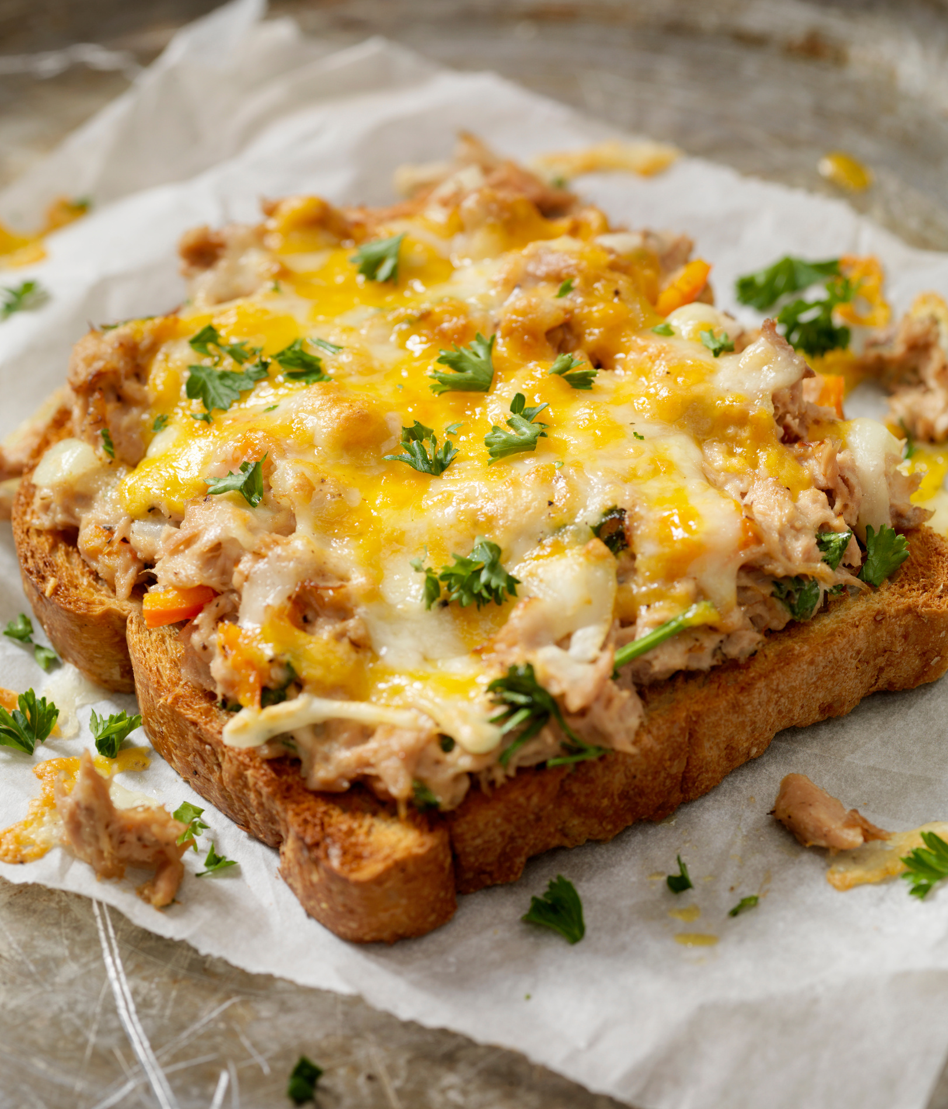

LUNCH
1
10 Minute Tuna Melt
  Tuna
  celery stalk, chopped
  red pepper
  pepper
  Greek yogurt
  4 teaspoons mayonnaise or softened butter
  whole-grain bread
  2 slices sharp Cheddar cheese
Mix yoghurt, chopped celery, chopped red pepper and ground pepper in a bowl with salt to taste
Smear either mayonnaise or softened butter on whole-grain bread
Add Mixture on bread and add your cheese on top of mixture ( Heat until cheese is melted)

Slide 7
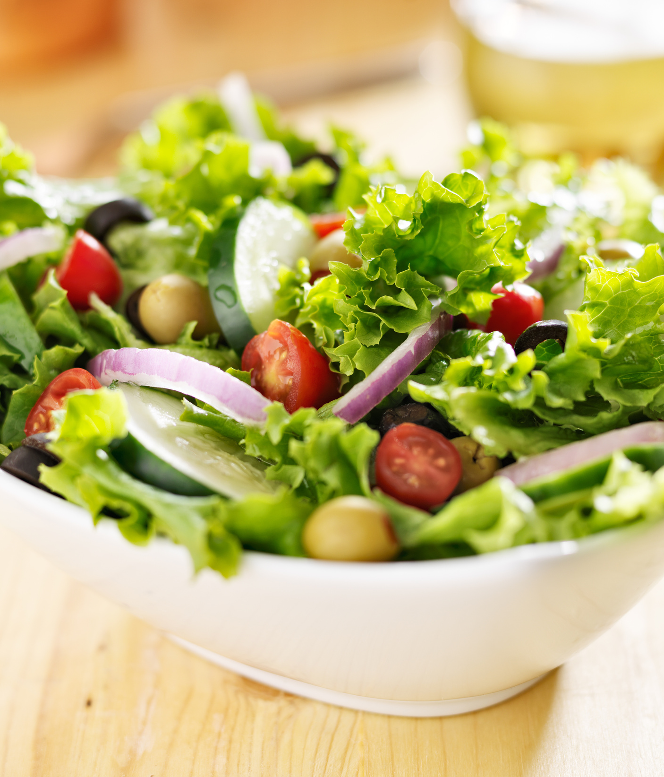
LUNCH
2
Green salad
  Lettuce
  Cucumber
  Tomatoes
  Feta Cheese
  olives
  French Dressing
In a medium bowl, add your lettuce
Clean your cucumber chop it
Dice your rinsed tomatoes and place them with your cucumber
add your feta cheese followed by your olives and French dressing
Add Chicken fillet strips to make it more filling

Slide 8
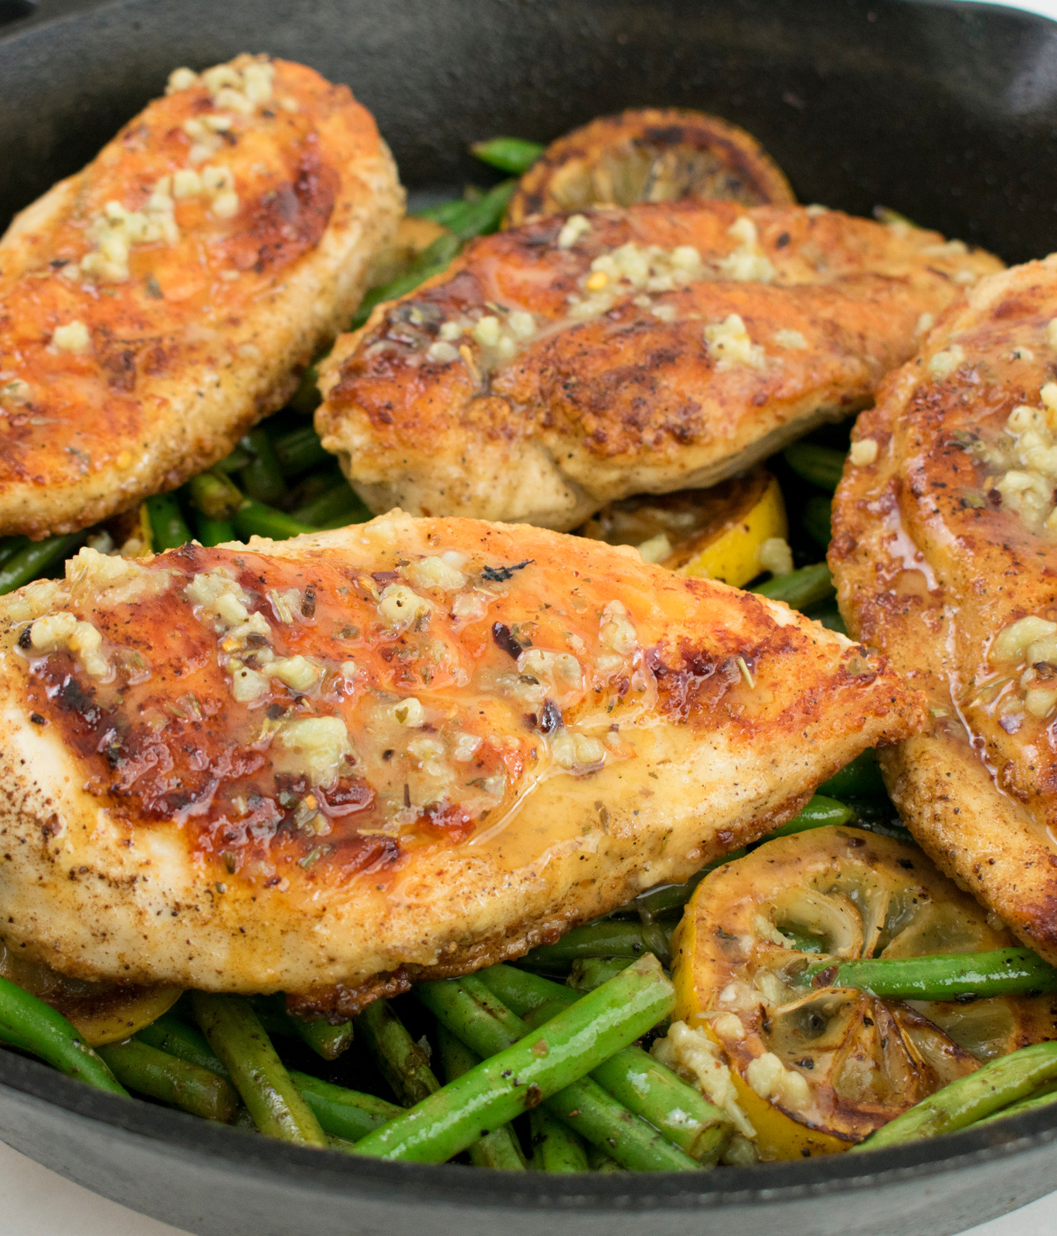
DINNER
LEMON GARLIC BUTTER CHICKEN AND GREEN BEANS
  skinless, boneless chicken thighs
  green beans, trimmed
  butter
  garlic cloves
  paprika
  onion
  black pepper
  lemon juice for garnish
  1/2 cup fresh chopped parsley
1
Combine paprika, salt, and pepper. Season chicken thighs generously with the spice mixture
Lay the seasoned chicken thighs in one layer in the skillet. Cook for 5-6 minutes then flip and cook another 5-6 minutes, until cooked through . If chicken browns too quickly, lower the heat. Add Garlic.
Cook Beans the microwave for 8-10 minutes, until almost done but still crisp.

Slide 9
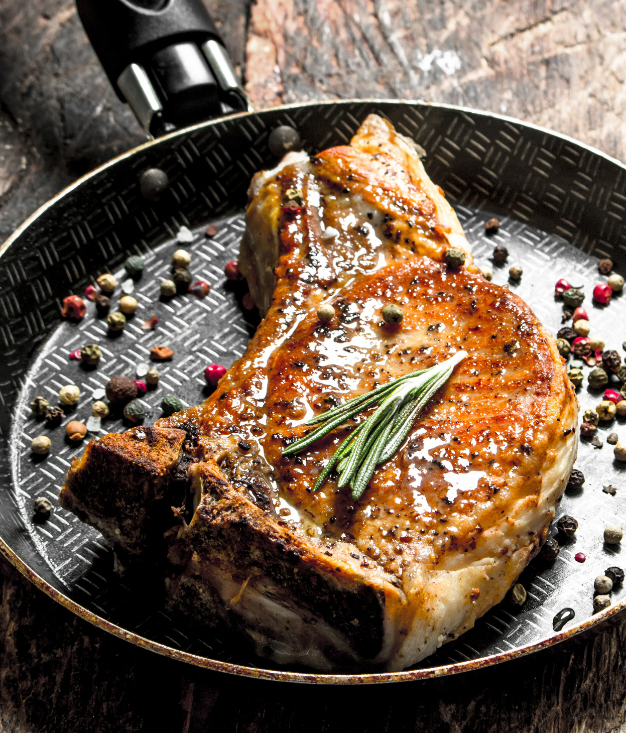
DINNER
Pork Chop / Fillet with salad
  Pork chops / Fillet
  salt and ground black pepper, to taste
  herbs (Rosemary)
  paprika
  olive oil
  Lemon Juice
1
Remove the rind and excess fat from the chops, leaving just a thin layer of fat. Season the meat well with salt, pepper, a sprinkling of herbs and just enough paprika to leave an impression.
Rub a layer of olive oil over the meat and a squeeze of lemon juice if desired. Let the chops marinate in the pan
Add Greek Salad

Slide 10
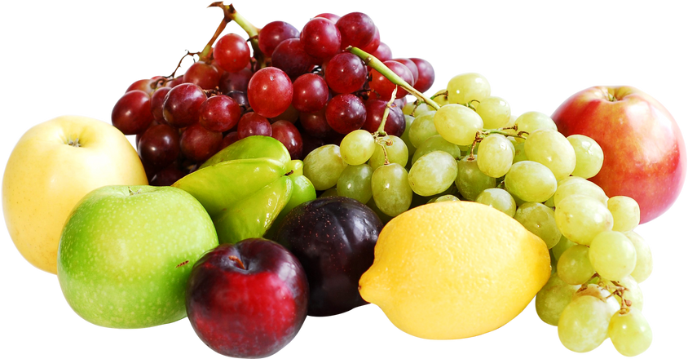

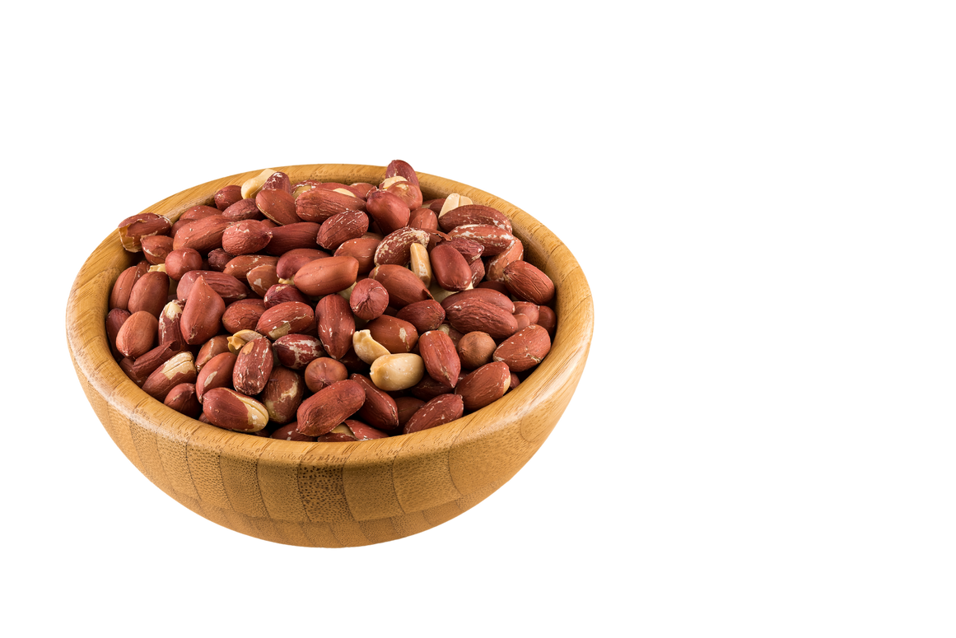
HEALTHY SNACKING
Snacking is a common part of our daily lives, and when done right, it can be a valuable addition to a healthy diet.
  Acknowledging the Role of Snacks in Daily Nutrition
  Maintaining Steady Energy Levels
  Curbing Overeating at Main Meals
  Enhancing Mood and Cognitive Function

Slide 11



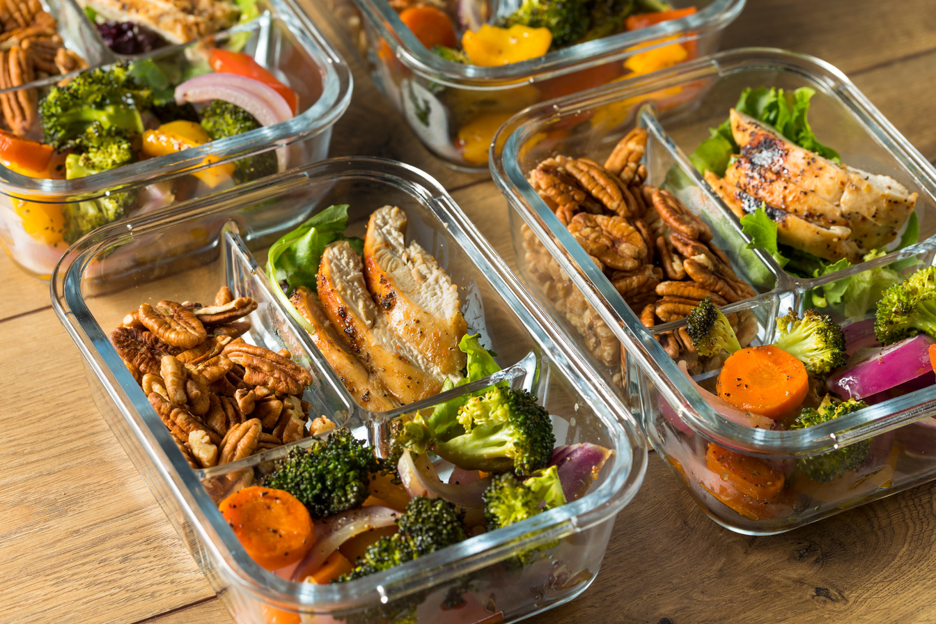
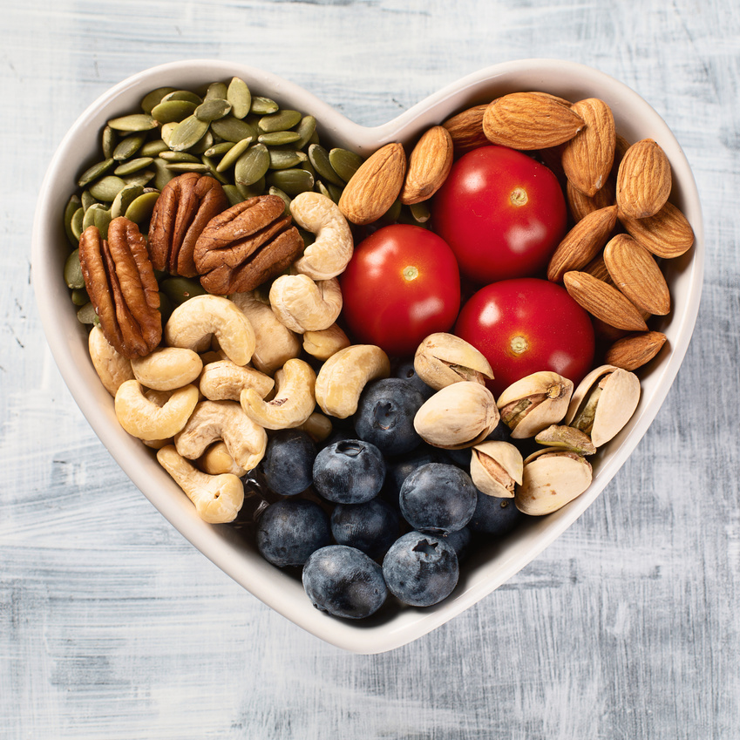
TIPS FOR MEAL PLANNING AND PREPPING
Set Aside Time
Schedule meal planning and prep time in your weekly calendar.
Batch Cooking
Prepare larger quantities to have meals ready for the entire week.
On-the-Go Snacks
Prep healthy snacks like trail mix or portioned cut veggies for quick access.

Slide 12


